Slide 1
Attention Models in Deep Learning
By
Chandresh Kumar Maurya
CSE deptt, IIT Indore
https://chandu8542.github.io/

Slide 2
Slides credit
Prof. Ming Li, Deep Learning and NLP course, UoW
Amaia Salvador, DCU, Dublin
Prof. Chris Manning, Stanford NLP course CS 224n

Slide 3
Introduction and Motivation
Seq-2-seq
Attention
Transformers
CONTENT

Slide 4
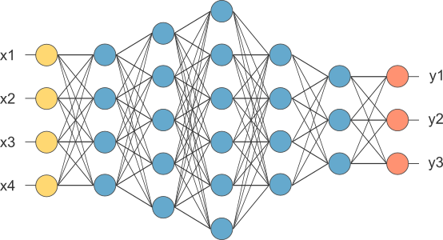
1. Fully connected network, feedforward network
To learn the weights on
the edges

Slide 5
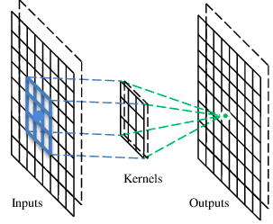
2. CNN
A CNN is a neural network with some convolutional layers
(and some other layers). A convolutional layer has a number
of filters that do convolutional operation.
A filter

Slide 6
These are the network parameters to be learned.
Convolutional layer
1 | -1 | -1
-1 | 1 | -1
-1 | -1 | 1
1 | 0 | 0 | 0 | 0 | 1
0 | 1 | 0 | 0 | 1 | 0
0 | 0 | 1 | 1 | 0 | 0
1 | 0 | 0 | 0 | 1 | 0
0 | 1 | 0 | 0 | 1 | 0
0 | 0 | 1 | 0 | 1 | 0
Filter 1
-1 | 1 | -1
-1 | 1 | -1
-1 | 1 | -1
Filter 2
……
Input
Each filter detects a small pattern (3 x 3).

Slide 7
Convolution
Operation
1 | -1 | -1
-1 | 1 | -1
-1 | -1 | 1
Filter 1
stride=1
1 | 0 | 0 | 0 | 0 | 1
0 | 1 | 0 | 0 | 1 | 0
0 | 0 | 1 | 1 | 0 | 0
1 | 0 | 0 | 0 | 1 | 0
0 | 1 | 0 | 0 | 1 | 0
0 | 0 | 1 | 0 | 1 | 0
Dot
product
3
-1
Input

Slide 8
1 | -1 | -1
-1 | 1 | -1
-1 | -1 | 1
Convolution
Filter 1
stride=1
1 | 0 | 0 | 0 | 0 | 1
0 | 1 | 0 | 0 | 1 | 0
0 | 0 | 1 | 1 | 0 | 0
1 | 0 | 0 | 0 | 1 | 0
0 | 1 | 0 | 0 | 1 | 0
0 | 0 | 1 | 0 | 1 | 0
3
-1
-3
-1
-3
1
0
-3
-3
-3
0
1
3
-2
-2
-1
Input

Slide 9

3. RNN
Parameters to be learned:
U, V, W

Slide 10
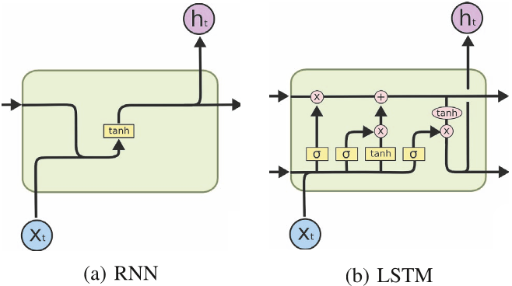
Simple RNN vs LSTM

Slide 11
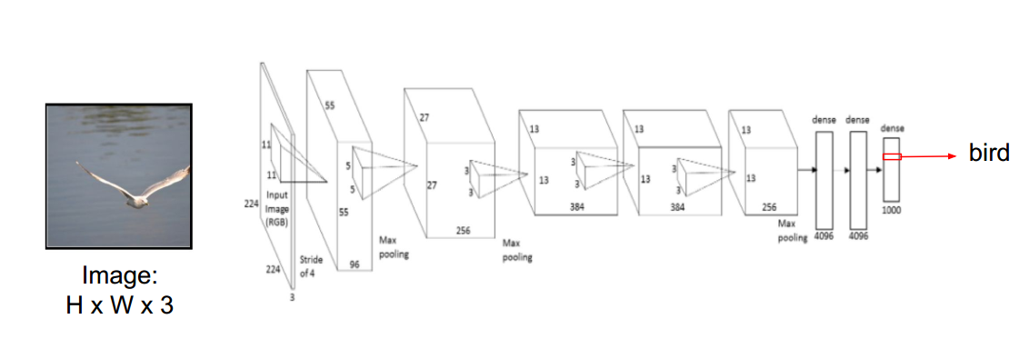
Attention Models: Motivation

Slide 12
Attention Models: Motivation
What is wrong here?

Slide 13
Attention Models: Motivation
What is wrong here? The whole input volume is used to predict the output… despite the fact that not all pixels are equally important

Slide 14
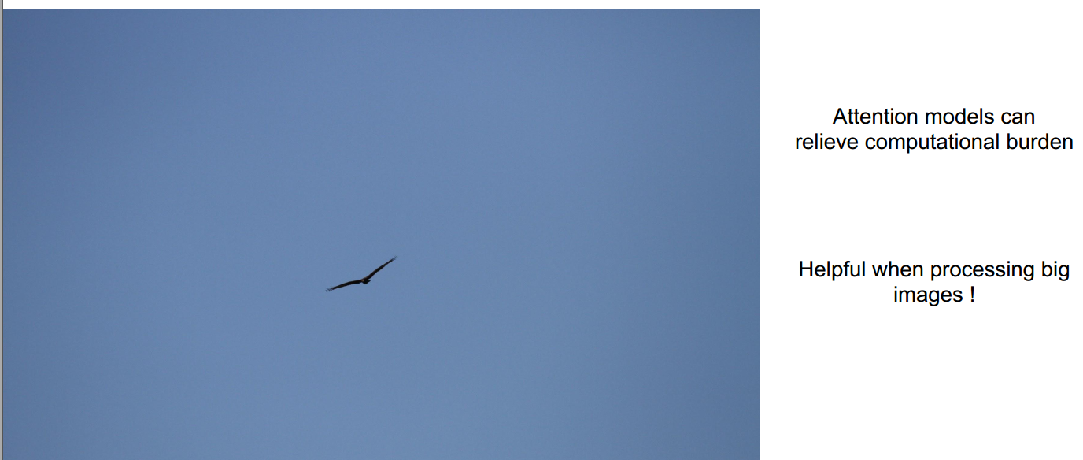
Attention Models: Motivation

Slide 15
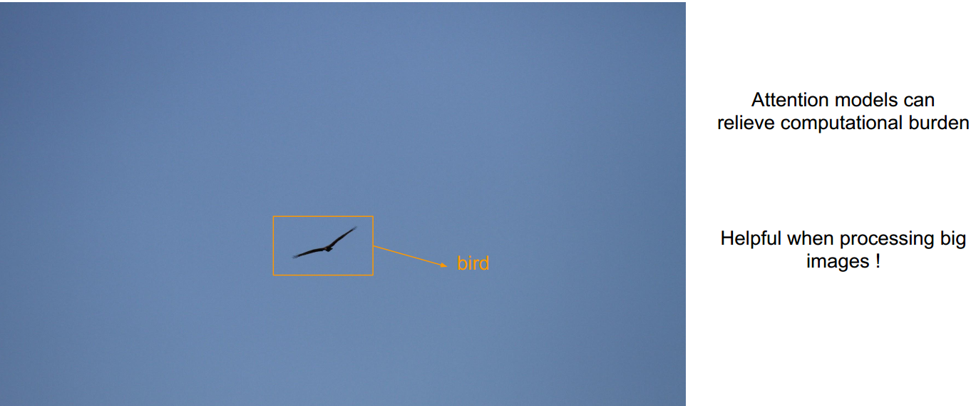
Attention Models: Motivation

Slide 16
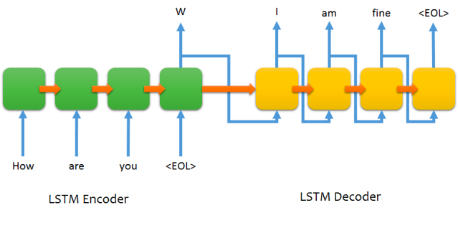
Encoder-Decoder LSTM structure for chatting (for non-intelligent beings)

Slide 17
Encoder-Decoder LSTM structure for chatting (for non-intelligent beings)
What is wrong here?

Slide 18
Encoder-Decoder LSTM structure for chatting (for non-intelligent beings)
What is wrong here?
Limtation 1: The whole information is encoded in a fixed-size vector, no
matter the length of the input sentence.

Slide 19
Encoder-Decoder LSTM structure for chatting (for non-intelligent beings)
What is wrong here?
Limitation 2: All output predictions are based on the final and static
recurrent state of the encoder (hT).
No matter the output word being predicted at each time step, all input words are considered in an equal way.

Slide 20
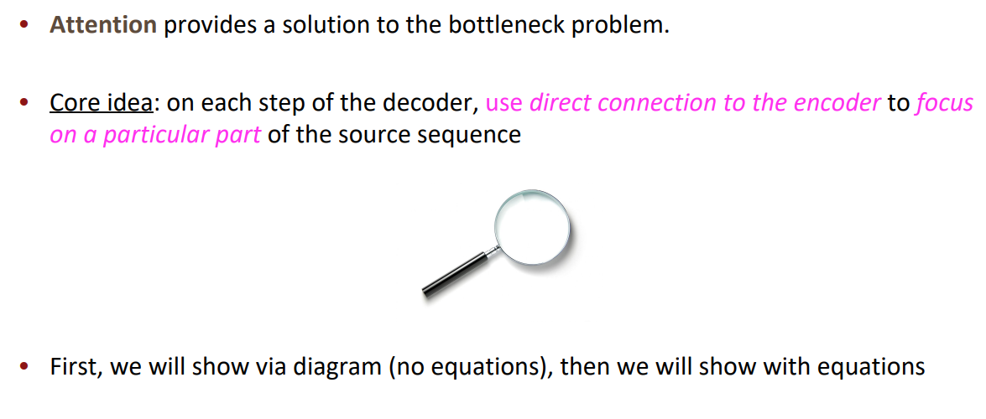
Attention!

Slide 21
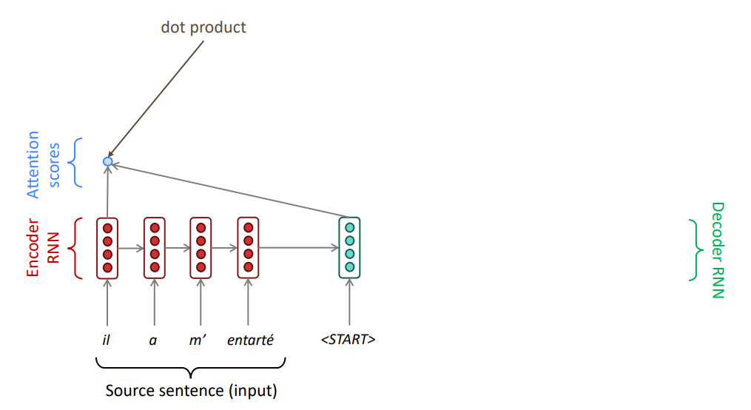
Seq-2-seq with Attention

Slide 22
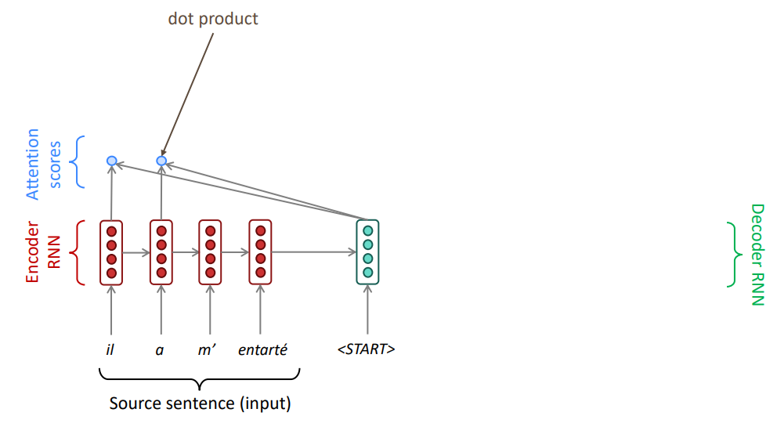
Seq-2-seq with Attention

Slide 23
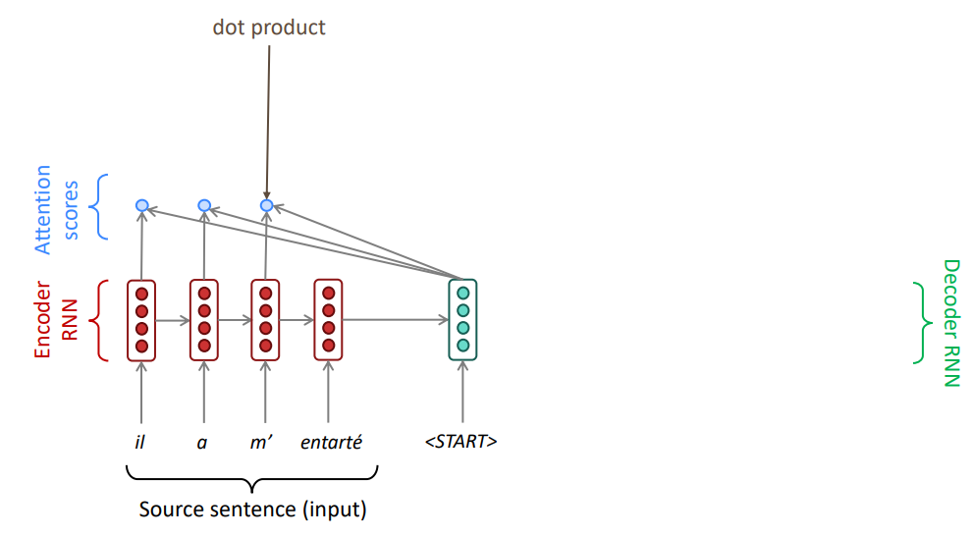
Seq-2-seq with Attention

Slide 24
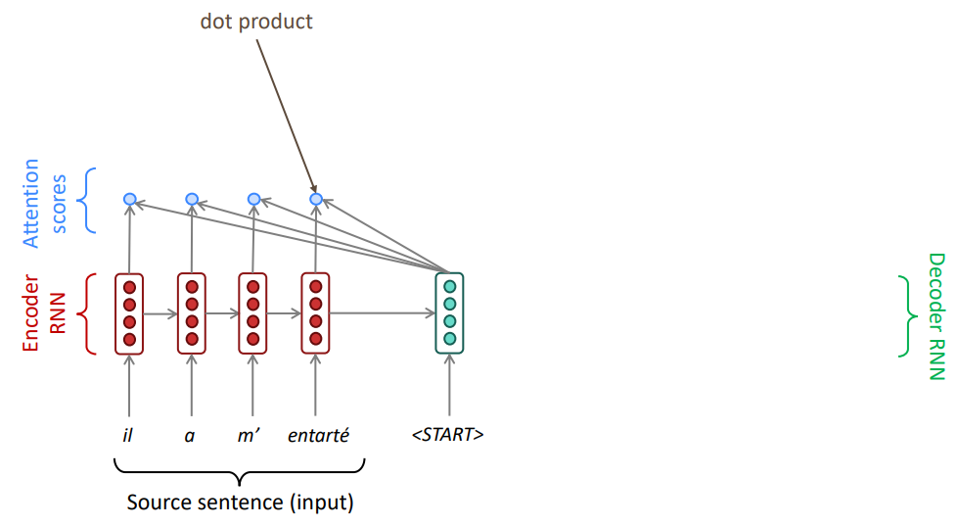
Seq-2-seq with Attention

Slide 25
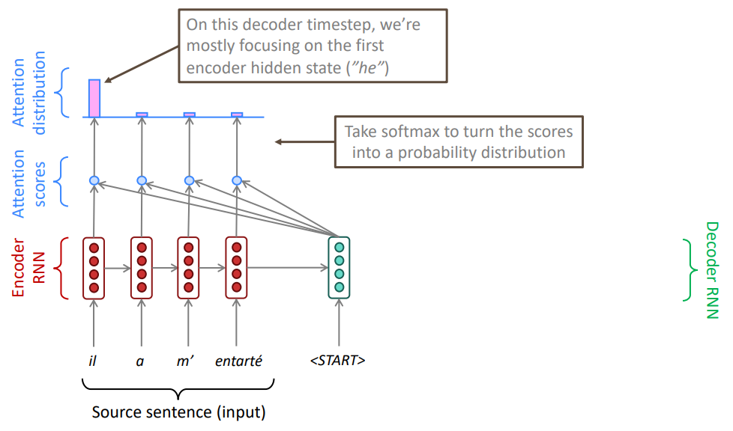
Seq-2-seq with Attention

Slide 26
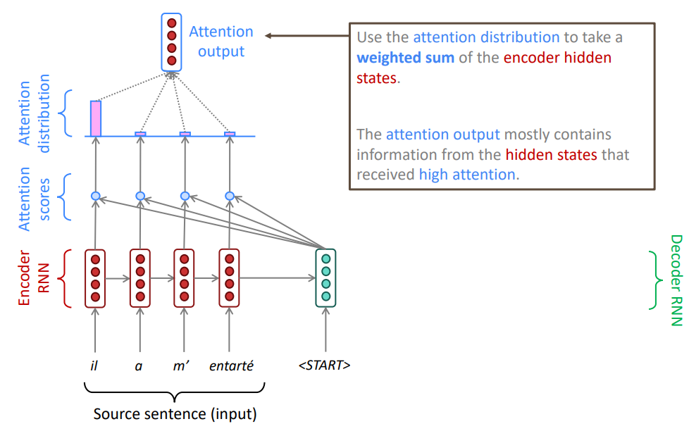
Seq-2-seq with Attention

Slide 27
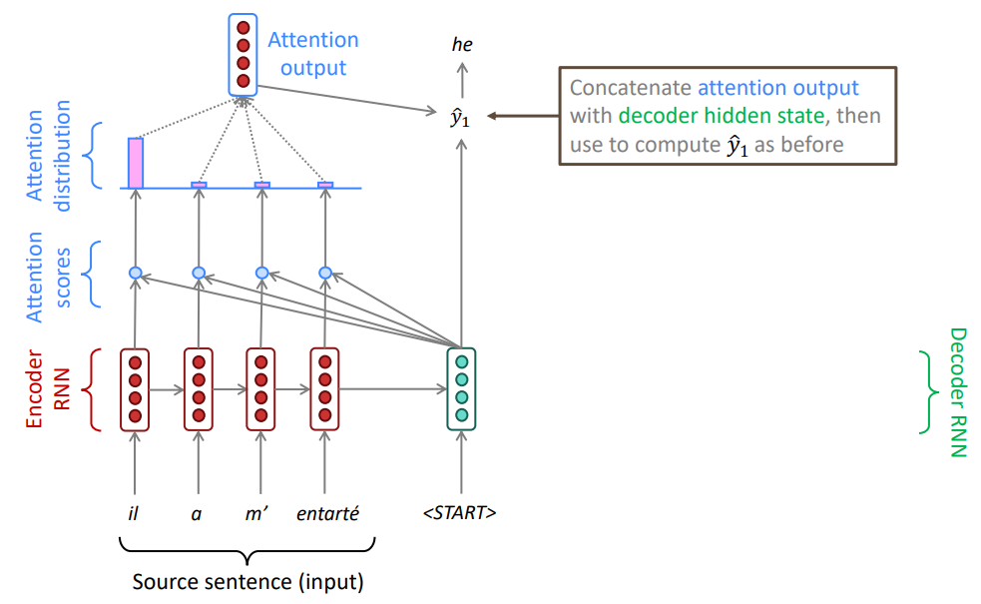
Seq-2-seq with Attention

Slide 28
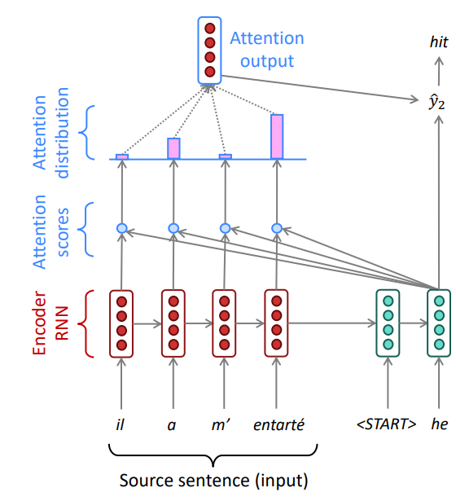
Seq-2-seq with Attention
Sometimes we take the attention output from the previous step, and also feed it into the decoder (along with the usual decoder input).

Slide 29
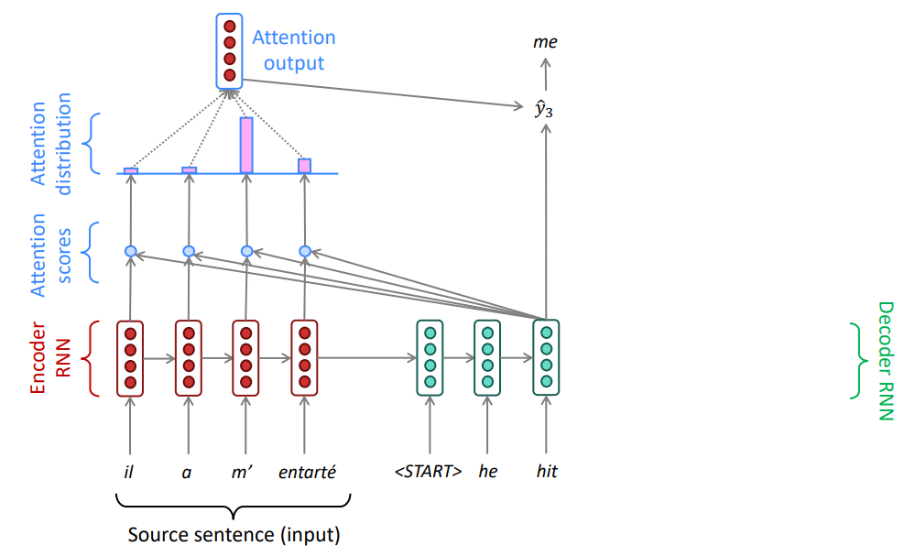
Seq-2-seq with Attention

Slide 30
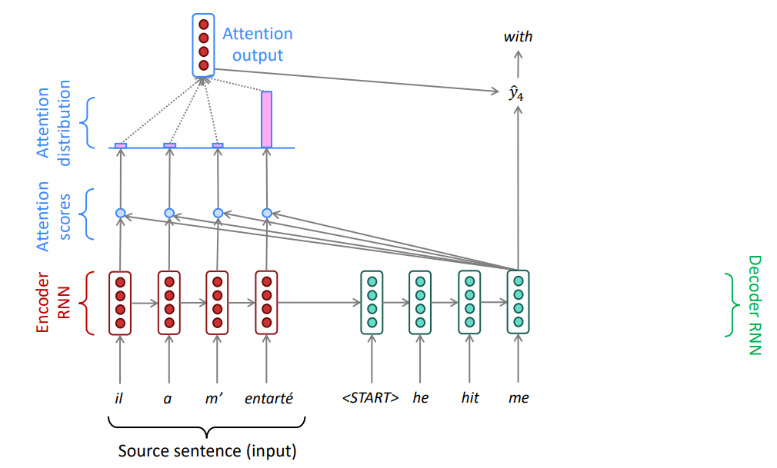
Seq-2-seq with Attention

Slide 31
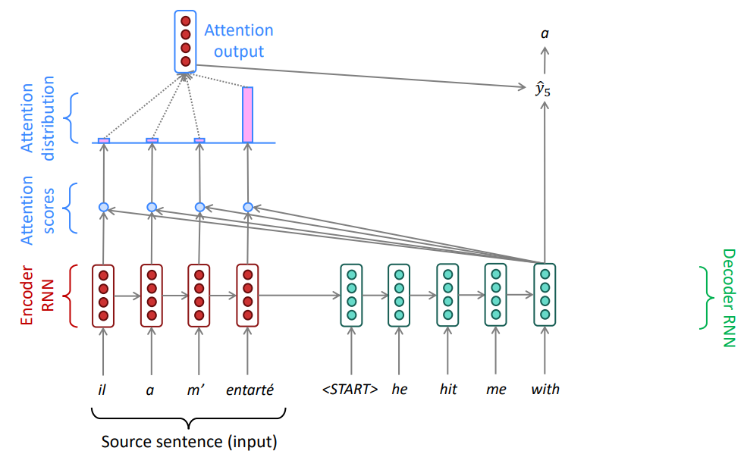
Seq-2-seq with Attention

Slide 32
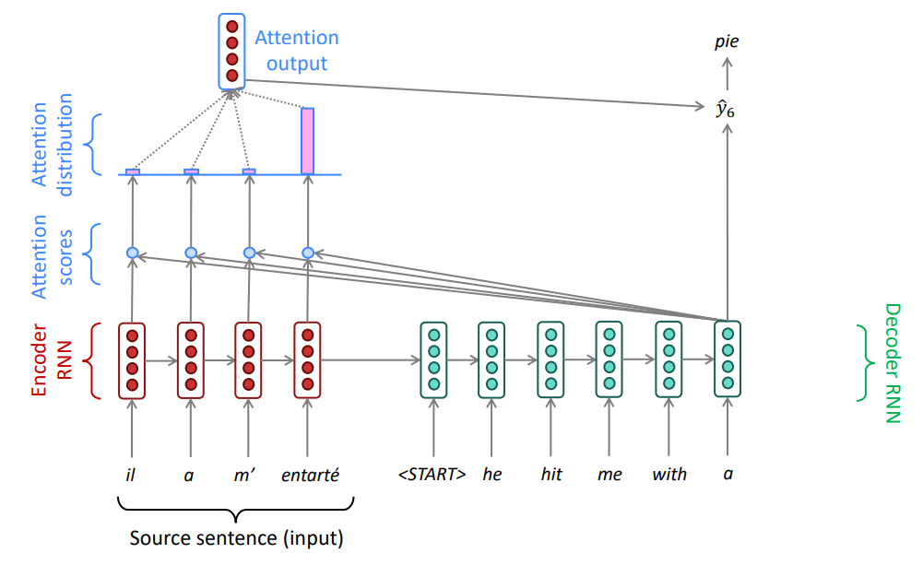
Seq-2-seq with Attention

Slide 33
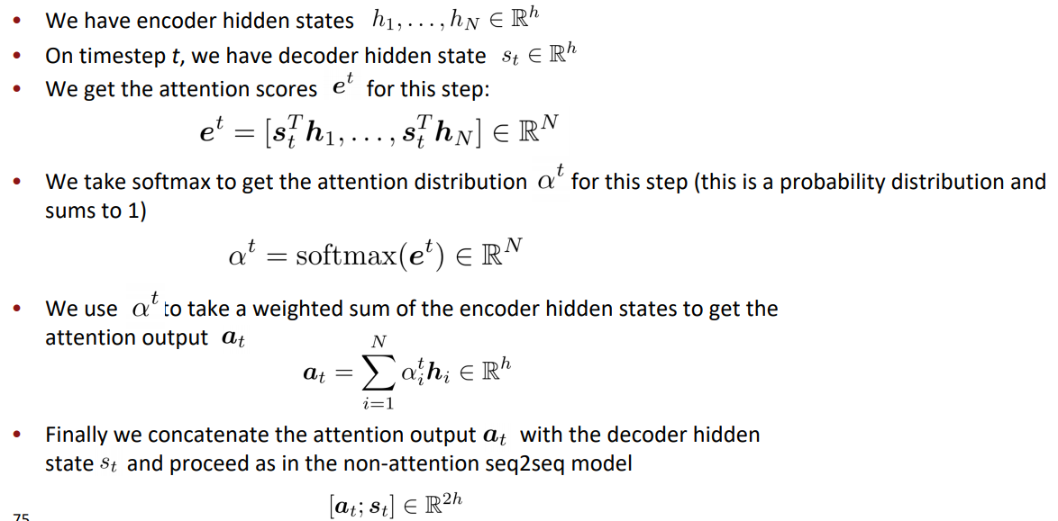
Attention: in equations

Slide 34
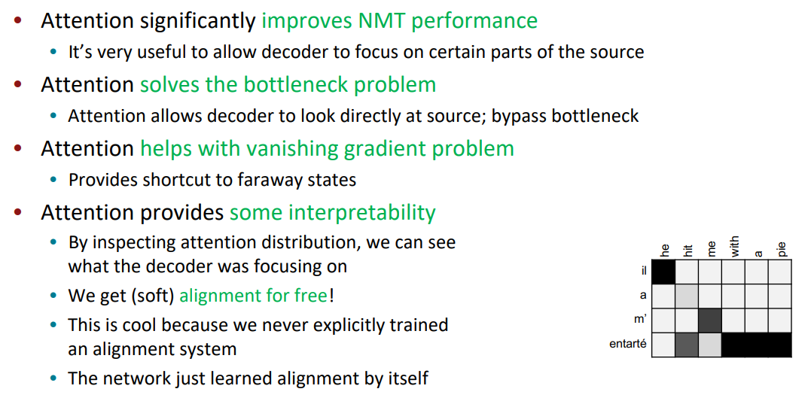
Attention is Great

Slide 35
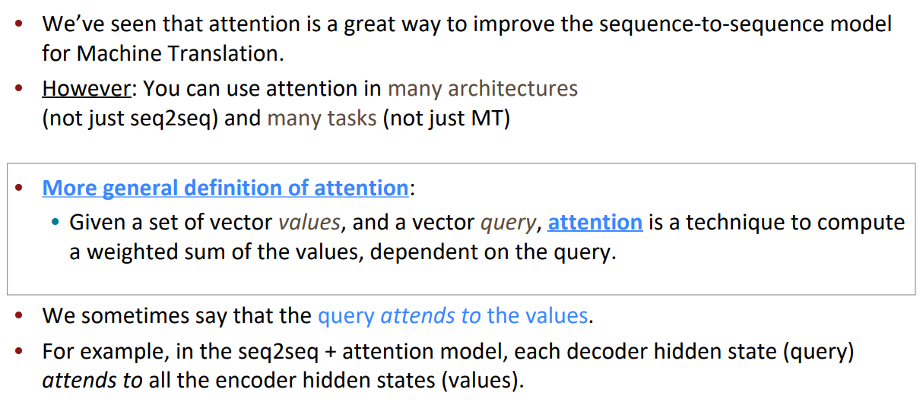
Attention is a general Deep Learning technique

Slide 36
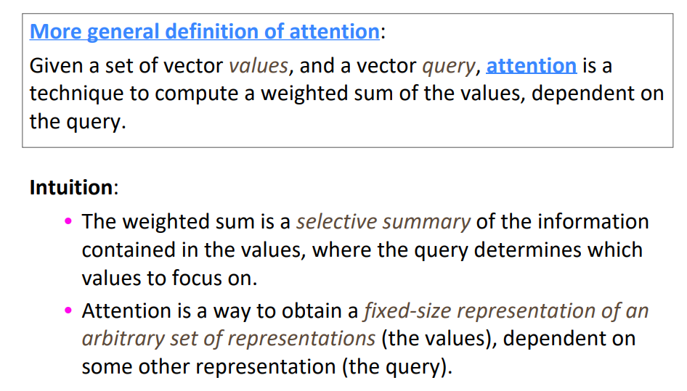
Attention is a general Deep Learning technique

Slide 37
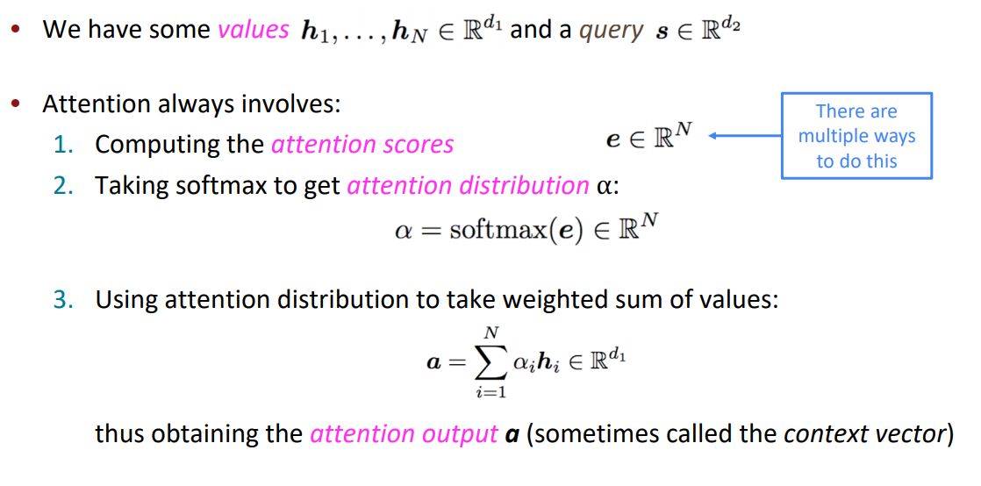
There are several attention variants

Slide 38
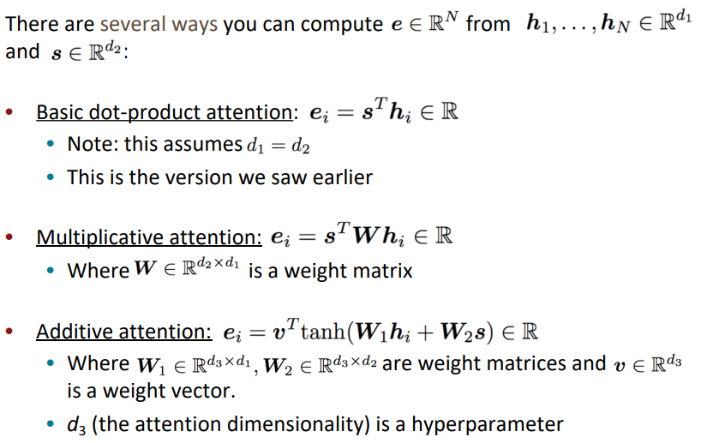
There are several attention variants

Slide 39
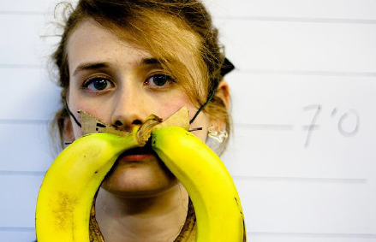
Image caption generation using attention
A vector for each region
z⁰ is initial parameter, it is also learned
match
z⁰
0.7
CNN
filter
filter
filter
filter
filter
filter
filter
filter
filter
filter
filter
filter

Slide 40
Image caption generation using attention
Word 1
A vector for each region
z⁰
z¹
Attention to
a region
weighted sum
CNN
filter
filter
filter
filter
filter
filter
0.7
0.1
0.1
0.1
0.0
0.0
filter
filter
filter
filter
filter
filter

Slide 41
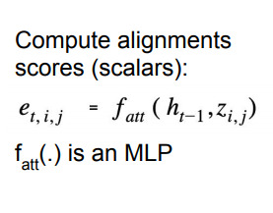
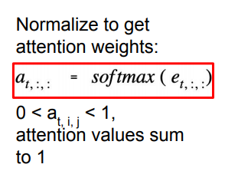
Image caption generation using attention
Word 1
Word 2
A vector for each region
z²
z⁰
z¹
weighted sum
CNN
filter
filter
filter
filter
filter
filter
0.0
0.8
0.2
0.0
0.0
0.0
filter
filter
filter
filter
filter
filter

Slide 42
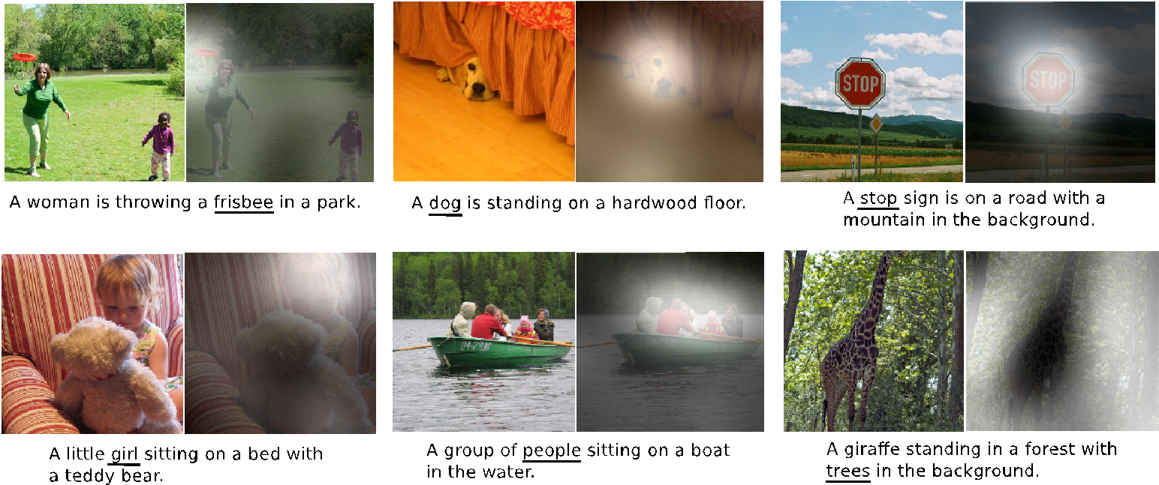
Image caption generation using attention
Kelvin Xu, Jimmy Ba, Ryan Kiros, Kyunghyun Cho, Aaron Courville, Ruslan Salakhutdinov, Richard Zemel, Yoshua Bengio,
“Show, Attend and Tell: Neural Image Caption Generation with Visual Attention”, ICML, 2015

Slide 43
02
Attention and Transformers
Many new ideas
ULM-FiT, pre-training, transfer learning in NLP
Recurrent models require linear sequential computation, hard to parallelize. ELMo, bidirectional LSTM.
In order to reduce such sequential computation, several models based on CNN are introduced, such as ConvS2S and ByteNet. Dependency for ConvS2S needs linear depth, and ByteNet logarithmic.
The transformer is the first transduction model relying entirely on self-attention to compute the representations of its input and output without using RNN or CNN.

Slide 44

Attention and Transformers
Transformer

Slide 45
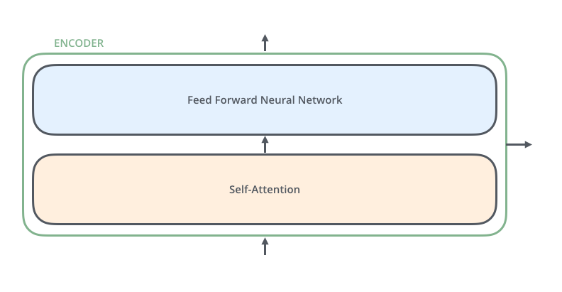
Attention and Transformers
An Encoder Block: same structure, different parameters

Slide 46
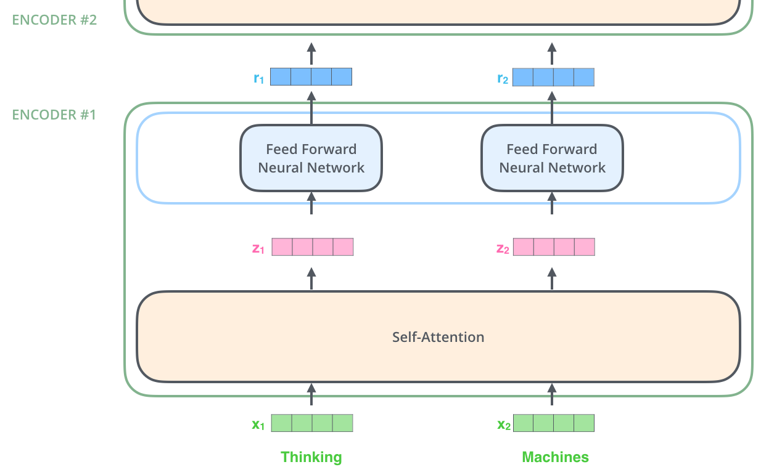
Attention and Transformers
Encoder
Note: The ffnn is independent
for each word.
Hence can be parallelized.

Slide 47

Attention and Transformers
Self Attention
First we create three vectors
by multiplying input embedding
(1x512)
x_{i} with three matrices (64x512):
q_{i} = x_{i} W^{Q}
K_{i} = x_{i} W^{K}
V_{i} = x_{i} W^{V}
Notes:
Dimension of q,k,v

Slide 48
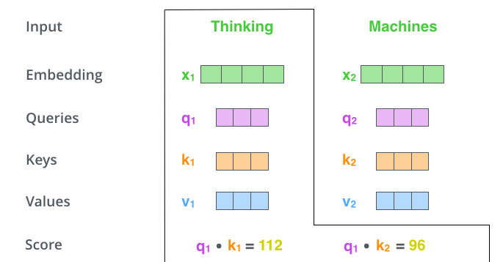
Attention and Transformers
Self Attention
Now we need to calculate
a score to determine how
much focus to place on other
Parts of the input.

Slide 49


Attention and Transformers
Self Attention
Formula
~
~
d_{k}=64 is dimension of key vector
z₁= 0.88v₁+ 0.12v₂
Notes:
v~

Slide 50
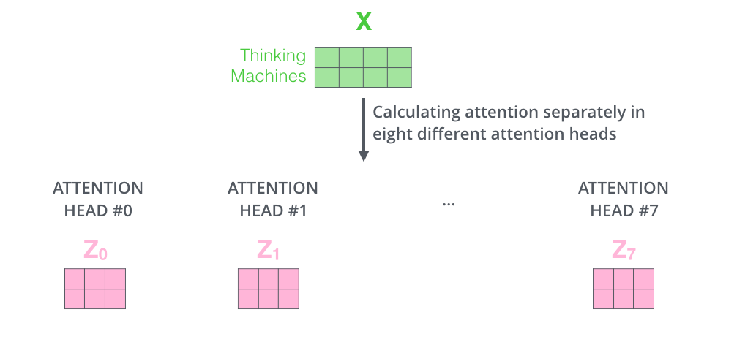
Attention and Transformers
Multiple heads
It expands the model’s ability to focus on different positions.
It gives the attention layer multiple “representation subspaces”

Slide 51
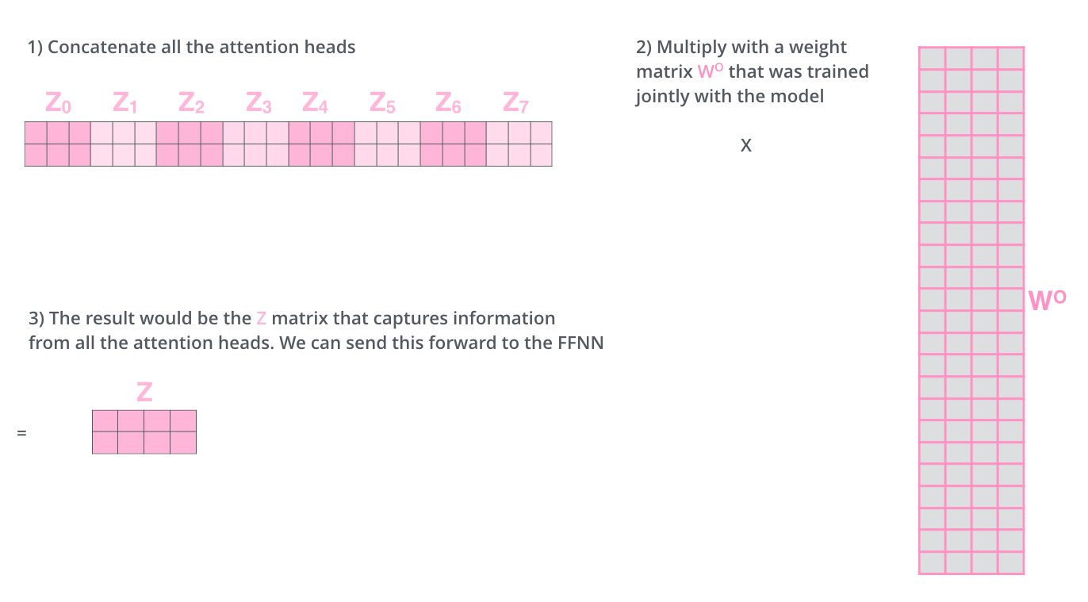
Attention and Transformers
The output is expecting only a 2x4
(|input|x64) matrix, hence,
Notes:
What about order? What happens if scale of these vectors are out of proportion?

Slide 52
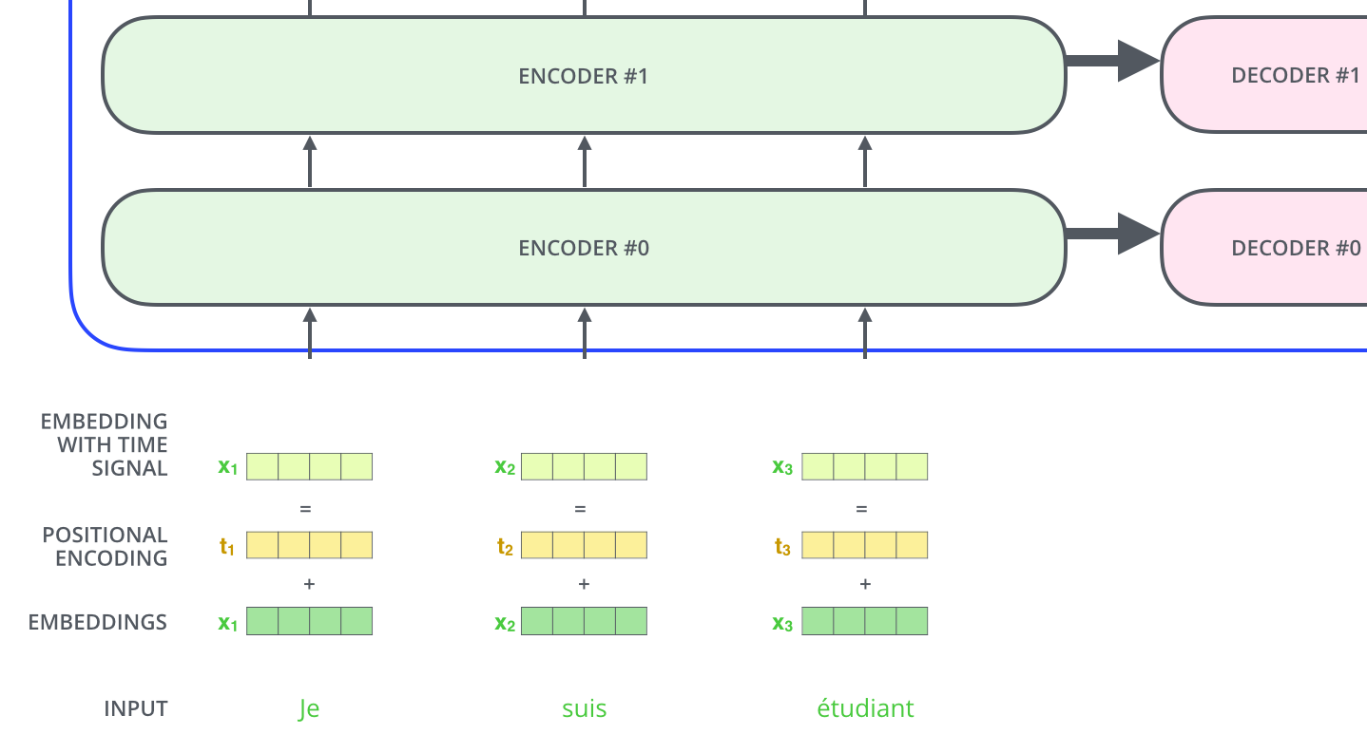
Attention and Transformers
Representing the input order (positional encoding)
The transformer adds a vector to each input embedding. These vectors follow a specific pattern that the model learns, which helps it determine the position of each word, or the distance between different words in the sequence. The intuition here is that adding these values to the embeddings provides meaningful distances between the embedding vectors once they’re projected into Q/K/V vectors and during dot-product attention.
Can somebody present positional encoding following https://kazemnejad.com/blog/transformer_architecture_positional_encoding/

Slide 53

Attention and Transformers
Add and Normalize
In order to regulate the computation, this is a normalization layer so that each feature (column) have the same average and deviation.

Slide 54
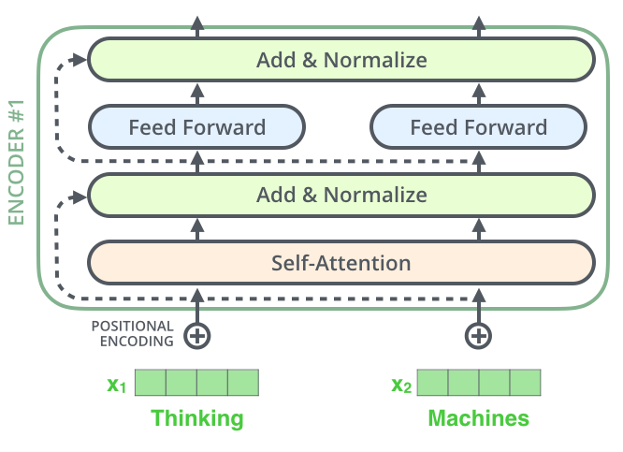
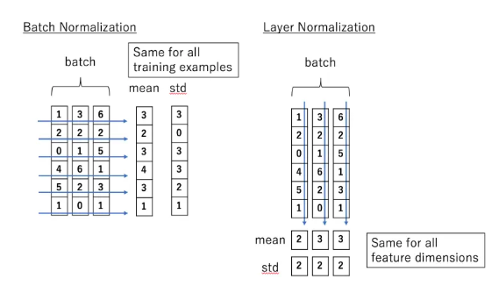
Attention and Transformers
Layer Normalization (Hinton)
Layer normalization normalizes the inputs across the features.

Slide 55

The complete transformer
The encoder-decoder attention is just like self attention, except it uses K, V from the top of encoder output, and its own Q

Slide 56
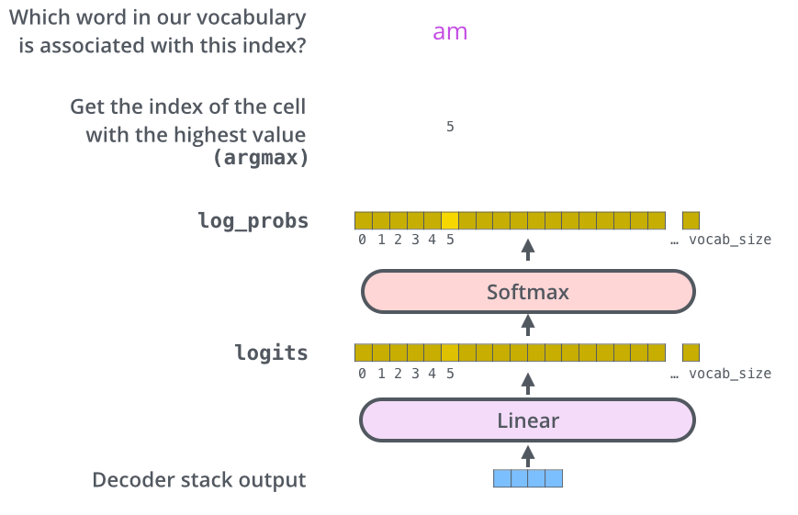
Attention and Transformers
Decoder’s
Output
Linear
Layer

Slide 57
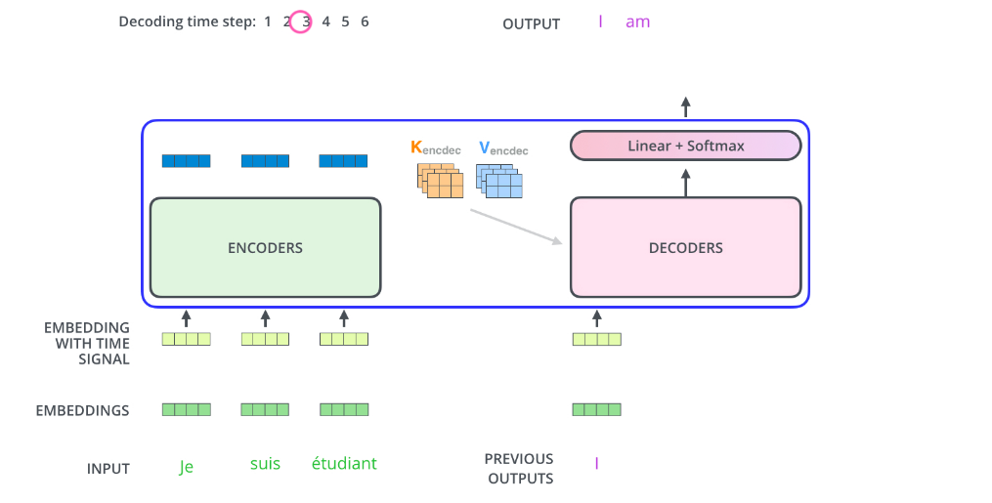
Attention and Transformers
How it works
Decoder’s
Output
Linear
Layer
But what about
Self-attention?

Slide 58
Attention and Transformers
But what about self-attention when the input is “incomplete”?
The solution is to set future unknown values with “-inf”.
The same for Encoder-Decoder Attention.

Slide 59
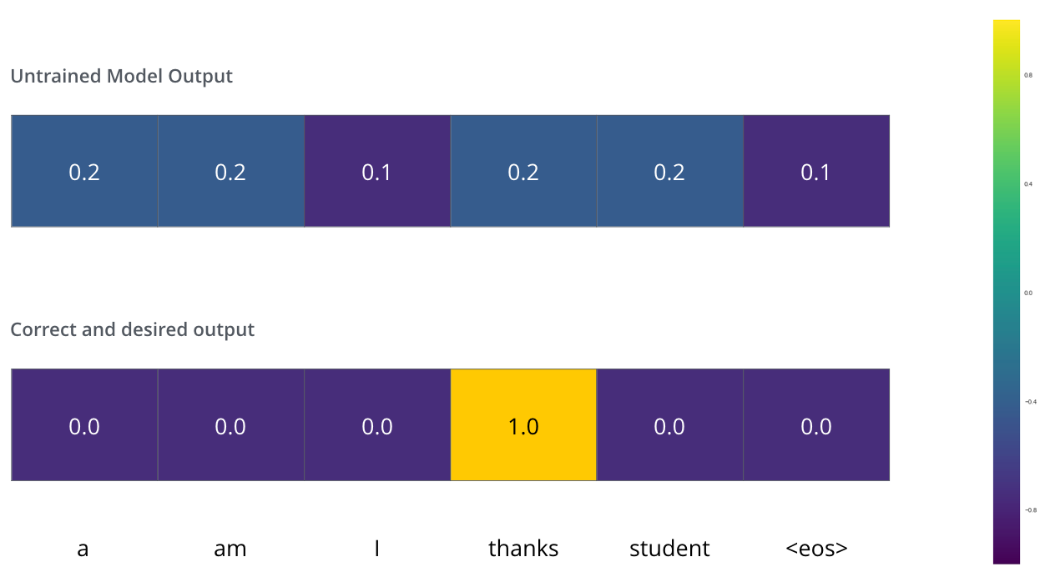
Attention and Transformers
Training and the Loss Function
We can use cross
Entropy.
We can also optimize two words at a time: using BEAM search: keep a few alternatives for the first word.

Slide 60
Attention and Transformers
Cross Entropy and KL (Kullback-Leibler) divergence
Entropy: E(P) = - Σ_{i}P(i)logP(i) - expected code length (also optimal)
Cross Entropy: C(P) = - Σ_{i}P(i) log Q(i) – expected coding
length using optimal code for Q
KL divergence:
D_{KL}(P || Q) = Σ_{i}P(i)log[P(i)/Q(i)] = Σ_{i}P(i)[logP(i) – logQ(i)], extra bits
JSD(P||Q) = ½ D_{KL}(P||M)+ ½ D_{KL}(Q||M), M= ½ (P+Q), symmetric KL
* JSD = Jensen-Shannon Divergency

Slide 61
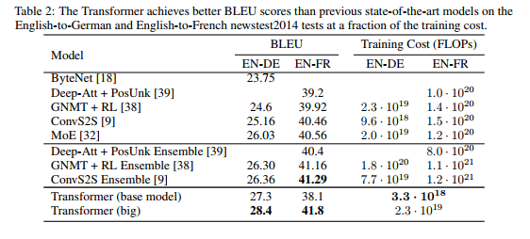
Attention and Transformers
Transformer Results

Slide 62
Thank you!
Q?

